Slide 1

TEAM CLOUD CHRONICLES
MIRCSOFT AZURE VIRTUAL HACATHON 2020-21
Athira Krishnakumar Nair, Prashant Islur, Ravi Singh, Dhruv Sharma
Team From New Zealand

Slide 2
Problem statement
Small businesses and start-ups are important for fostering local economies, reducing unemployment, and generating vibrant and supportive community.
US small business administration supports small businesses and start ups through a loan guarantee program. This program supports banks to grant loans to small businesses by reducing the risk of the banks to lose loan money as SBA guarantees the portion of the loan if the business default on repayment.
As SBA guarantees only a portion of the loan, banks still incur losses and hence face difficult in decision making to whether the loan should be approved or not.
There has been a lot of research and analysis on loan default situations but our main goal was to leverage the use of Microsoft Azure and AI platform and utilise our data science capabilities to build a predictive model that can identify the high risk customers.
Create an app using Power apps based on customer as well as banking perspective.
Build an end to end solution providing the customers and users an easy to use platform that is reliable and efficient.
Explore the opportunities of integrating Microsoft Azure Cognitive Services to provide AI solutions to assist with loan document application, determine client’s affordability and predict credit risk.
Objective

Slide 3
team approach to build azure ML solution
Research on data that aligns with the banking problem to address
Finalised the raw data that best aligns with the bank problem due to Covid-19 situation
Studied each and every column of the data. Data Pre-processing was carried out.
Used AutoML and Designer in Microsoft Azure to build the best ML models.
Deployed the ML model and used Power Automate to connect to Power Apps to built an interactive platform
Power BI to perform exploratory analysis and to choose the variables that will best support the prediction
End to End Solution thought process

Slide 4







Data overview
1900 - 2014
Accounted for variation due to the Great Recession (December 2007 to June 2009)
50 US States
City
Zip Code
Gross Disbursement Amount
Charged off Principal Amount
SBA Gross Approval Amount
Balance Gross Amount
Whether the business is new or existing one?
Term of the loan
Whether the company has gone through LowDoc Program?
Whether the company lies in the revolving credit line?
No. of Job Created and Retained
No. of employees in the company
Whether business is a franchise or self-owned?
Charged off
Bank State
Bank Name
Loan Digit Number
20 different industries loan records
Paid in Full

Slide 5
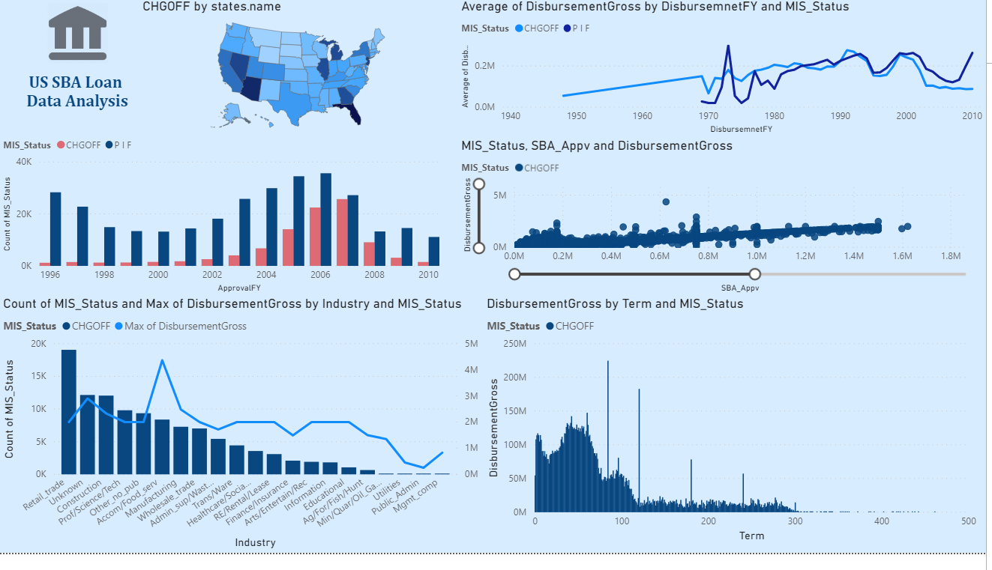
Exploratory Analysis using Power bi
Higher default rate has been observed in Florida, Georgia, Arizona, Nevada, Illinois, Michigan, and California
High default rate was evident due to Great Recession period (2007-2009).
A relatively positive correlation can be observed between the loan amount disbursed and SBA Approval amount. This tells us that higher the amount of loan, higher proportion of amount is guaranteed by SBA. Higher default rate has been observed where the SBA approved amount were less than or equal to 1.5M
Higher default rate has been observed in Retail and Trade Industry followed by construction, Science and Tech industry.
High default rate has been observed when the business took loan for less than 100-150 months.

Slide 6
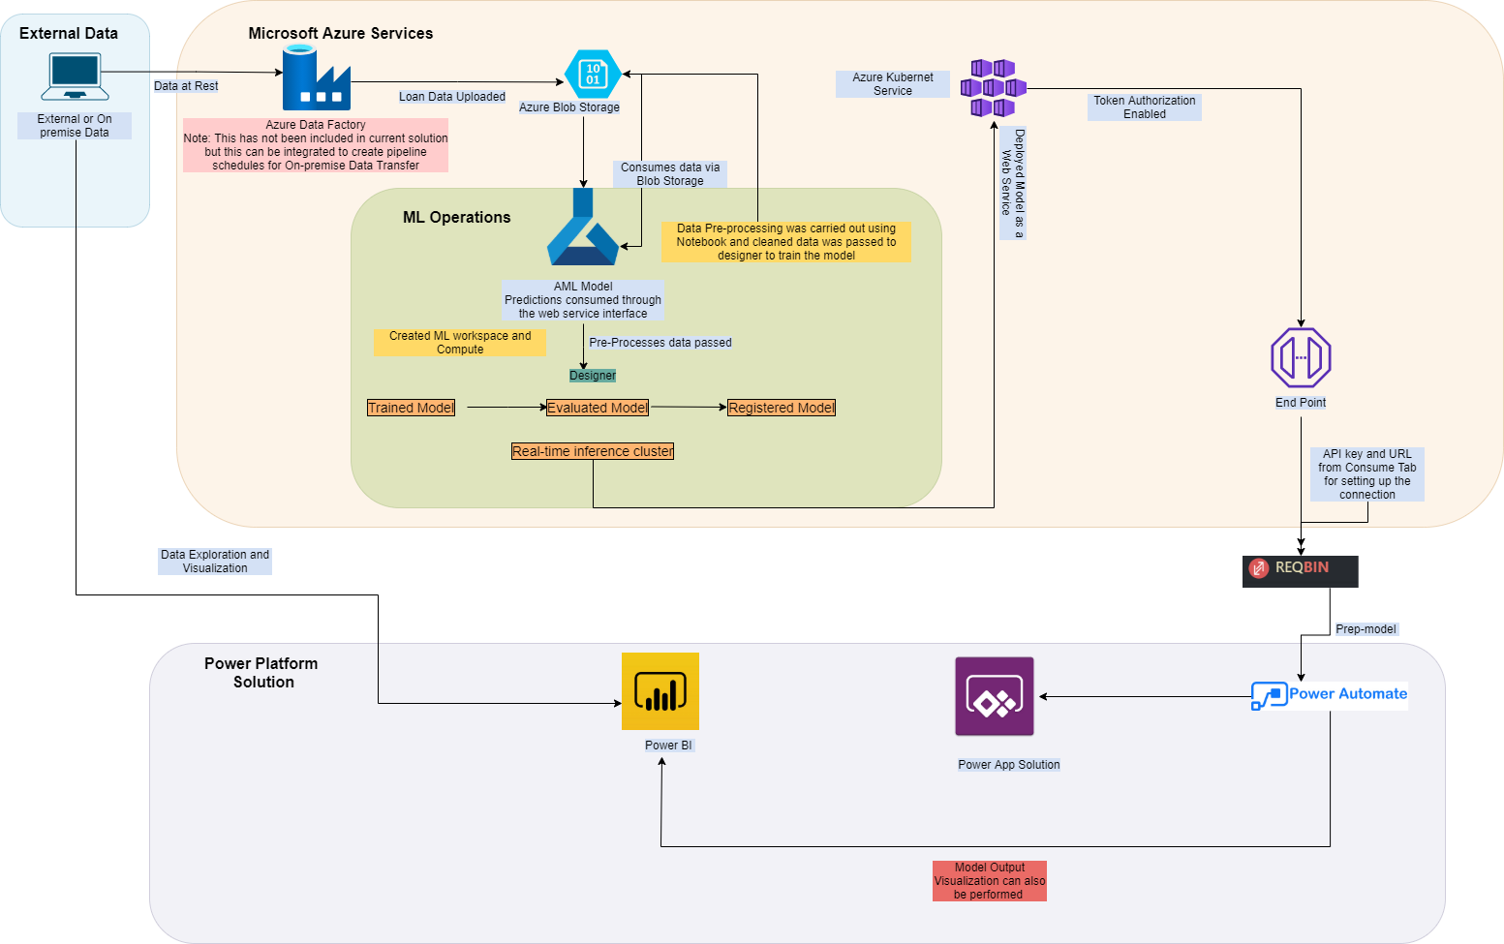
Our Microsoft Azure Architecture solution for loan prediction
The solution walks through the end-to-end process of how to develop predictive analytics using a set of simulated loan history data to predict loan charge off risk.
The solution template also includes a set of python scripts used to perform data pre-processing.
Exploratory analysis have been performed with pre-processed data using Power BI.
The solution also includes scripts to deploy the model as a webservice.
The model is consumed to Power Apps using Power Automate.

Slide 7
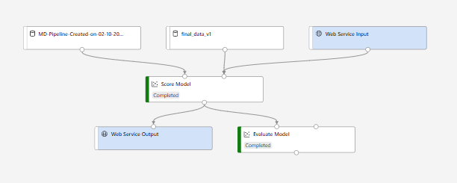
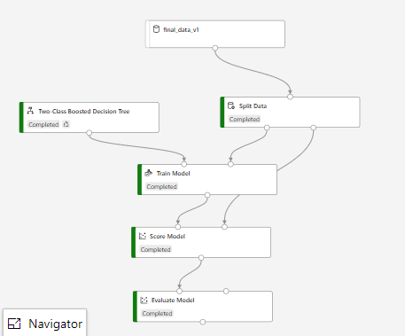
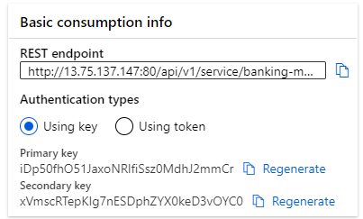
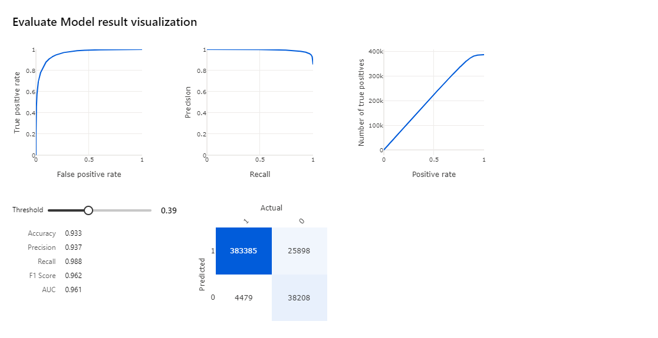
Designer Model Output
Model Flow
REST API Endpoint used to consume model
Results

Slide 8
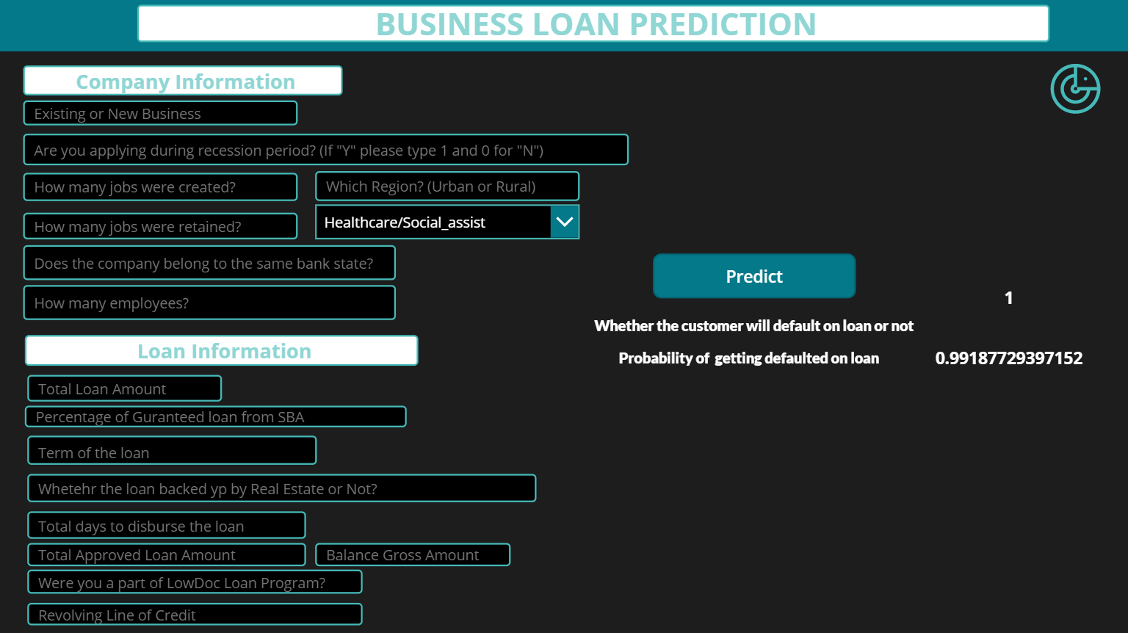
Power aPP solution
DEMO LINK :

Slide 9
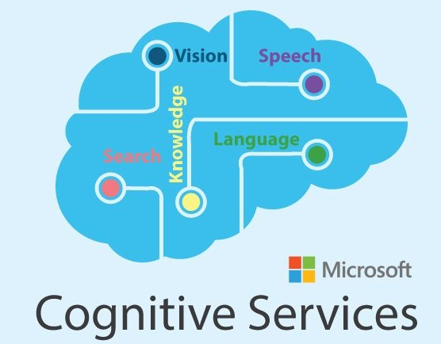








SOLUTION Use case
Loan Banking Providers
Streamlining the loan application process
Customer Segmentation
Consumers
Consumers can fill in their details to find out
Help Increase Customer Lifetime Value
Increase chances of cross selling
Reject Riskier Applicants
how likely are they to be offered a loan.
Like to Like customer credit worthiness.
Personalise repayment schedule to increase future loan approvals.
Managing Loan Portfolio Risk
Lower Operational Costs
Determining Customer Creditworthiness
Financial Institutions, Regulators and Venture Capitalists
Determining Industry Creditworthiness
Detection of Fraud Patterns
Anti Money Laundering
Financial Lending to Small Business Enterprises
Leveraging Azure Platform for ai, ml and aa
Model Development and Deployment
ML Pipeline Orchestration and Storage

Slide 10


KNOW the Team Behind This
Athira Krishnakumar Nair
Lead Data Scientist at Pyper Vision | Microsoft Data Analyst Associate Certified
Leads NZ Data Science and Machine Learning community with 60+ data scientist across industries.
Masters of Applied Data Science from University of Canterbury, New Zealand
Masters in Statistics from Narsee Monjee Institute of Management Studies
Chess Player, Dancer and Painter
Dhruv Sharma
BI & Data Science Specialist
Farmlands Cooperative Society Limited NZ
Ex Deloitte | 8+ Years Analytics Experience
Masters of Applied Data Science - University of Canterbury, NZ
Post Grad Dip in Business Management - Symbiosis International University
Problem Solver, Cricket Enthusiast

